Slide 1

Creating
Your
First
Blazor
Application
Daniel Villamizar
Senior Cloud Solutions Architect - MVP
@danielvillamizara – https://www.linkedin.com/in/danielvillamizara/

Slide 2


Module
overview
Exploring a new Blazor project
Creating a first Blazor application
Improving the layout
Debugging Blazor applications

Slide 3
Exploring
a
New
Blazor
Project

Slide 4
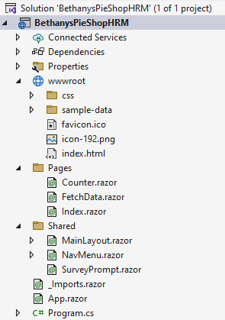
File à
New
Project
C# and .razor files
Structure similar to ASP.NET Core
project

Slide 5
Razor
Components
in
Blazor
Main building block in
*.razor files
Blazor
applications
Razor syntax
Contain UI and logic
-
-
Handle events
Logic typically in a component class
Rendered on the client
-
Not a request/response model

Slide 6
Razor
Components
in
Blazor
Often nested
Reused across the
application
or in a library
Class generated upon compilation

Slide 7

Component
names
must
start
with
an
uppercase!

Slide 8
Looking
at
a
First
Component
Counter.razor
@page
"/counter"
<h1>Counter</h1>
<p>Current
count:
@currentCount</p>
<button class="btn
btn-primary"
@onclick="IncrementCount">Click
me</button>
@code
{
int
currentCount
=
0;
void IncrementCount()
{
currentCount++;
}
}

Slide 9

@page
"/"
<h1>Hello,
world!</h1>
Welcome
to
your
new
app.
<Counter />
Using a Component

Slide 10
Hosting page
Plain HTML
Triggers loading of the Blazor app through
JavaScript
-
blazor.webassembly.js

Slide 11


Demo
Creating a new Blazor WebAssembly
project
Exploring the created files

Slide 12

New
to
ASP.NET
Core?
Razor
syntax confusing
Take a look at the
ASP.NET Core Learning Path!
you?

Slide 13
Creating
a
First
Blazor
Application

Slide 14
Using
Code
Mixed approach using @code
“Code behind” using partial

Slide 15
Using
the
Mixed
Approach
@page
"/counter"
<h1>Counter</h1>
<p>Current
count:
@currentCount</p>
<button class="btn
btn-primary"
@onclick="IncrementCount">Click
me</button>
@code
{
int
currentCount
=
0;
void IncrementCount()
{
currentCount++;
}
}

Slide 16
public
{
}
partial
class
EmployeeOverview
Using Partial Classes
Code-behind

Slide 17
Demo
Creating the first page of our application

Slide 18
Improving
the
Layout

Slide 19
Sharing
a
Layout
HEADER
MENU
MAIN CONTENT
FOOTER

Slide 20



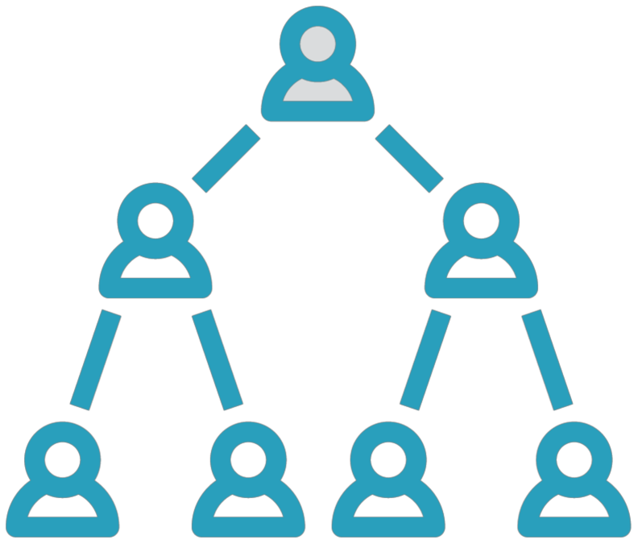
Adding
a
Layout
Shared UI across several pages
Referenced by
page
components
Shared folder
Inherit from LayoutComponentBase

Slide 21
Creating
LayoutComponentBase
a
Layout
Component
@inherits
<div class="page">
<div
class="sidebar">
<NavMenu
</div>
/>
<main>
<div
class="top-row
px-4">
<a
</div>
href="https://docs.microsoft.com/aspnet/"
target="_blank">About</a>
<article
class="content
px-4">
@Body
</article>
</main>
</div>

Slide 22
@page
"/employeeoverview"
@layout
BethanysPieShopMainLayout
Applying a Specific Layout

Slide 23
<Router
AppAssembly="@typeof(App).Assembly">
<Found
Context="routeData">
<RouteView
RouteData="@routeData"
DefaultLayout="@typeof(MainLayout)"
/>
<FocusOnNavigate
</Found>
...
</Router>
RouteData="@routeData"
Selector="h1"
/>
Using a Default Layout
Code from the App.razor

Slide 24
Demo
Improving the layout

Slide 25
Debugging
Blazor
Applications

Slide 26
Demo
Debugging Blazor applications

Slide 27
Summary
Components are the building block for any
Blazor app
Can be nested, reused… Layouts add consistency

Slide 28

Up
next:
Working
with
components

